Slide 1
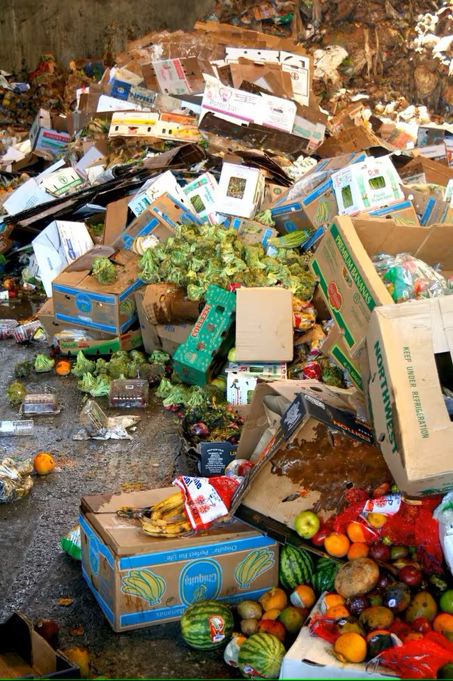
Shelf-Life Prediction of Fruits & Vegetables
Darshit bansal
Abhay singhal
Asmit yadav

Slide 2
Problem Overview
Significant wastage of fruits and vegetables occurs due to improper inventory penetration from dark stores, where 'more fresh' items are delivered before 'mild fresh' ones. This leads to early spoilage and inefficient stock rotation.
Increased Operational Costs.
Accelerated Spoilage of Adjacent Produce.
Supply Chain Inefficiencies.
Environmental Impact.
Economic Losses for Producers and Retailers.
Increased Food Prices and Reduced Affordability.

Slide 3
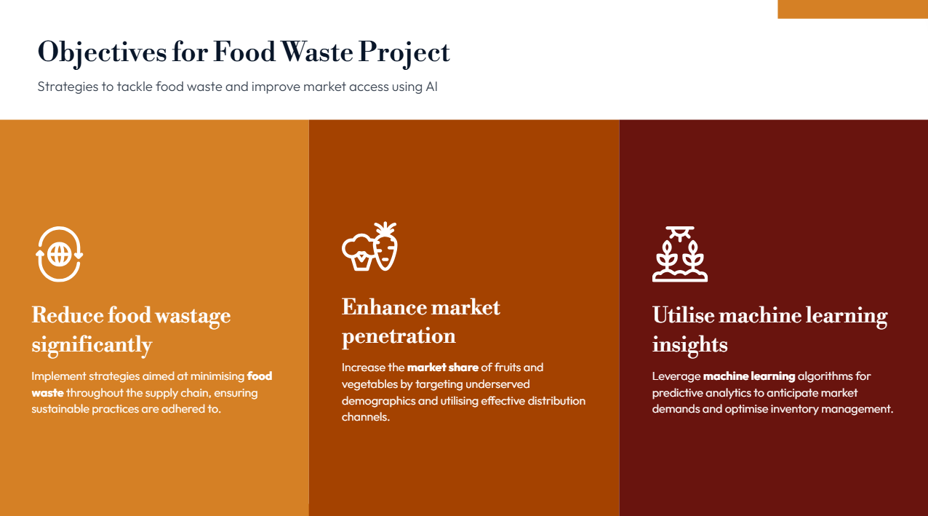

Slide 4
Introduction
"Shelf-Life Prediction of Fruits and Vegetables Using Machine Learning," addresses the critical issue of post-harvest losses due to spoilage. By leveraging advanced machine learning techniques, specifically Convolutional Neural Networks (CNN) for image classification and Vision Transformers (ViT) for shelf-life estimation, we aim to accurately predict the freshness duration of produce. This system empowers stakeholders in the agricultural and retail sectors to make informed decisions, optimize inventory management, and reduce food waste.

Slide 5
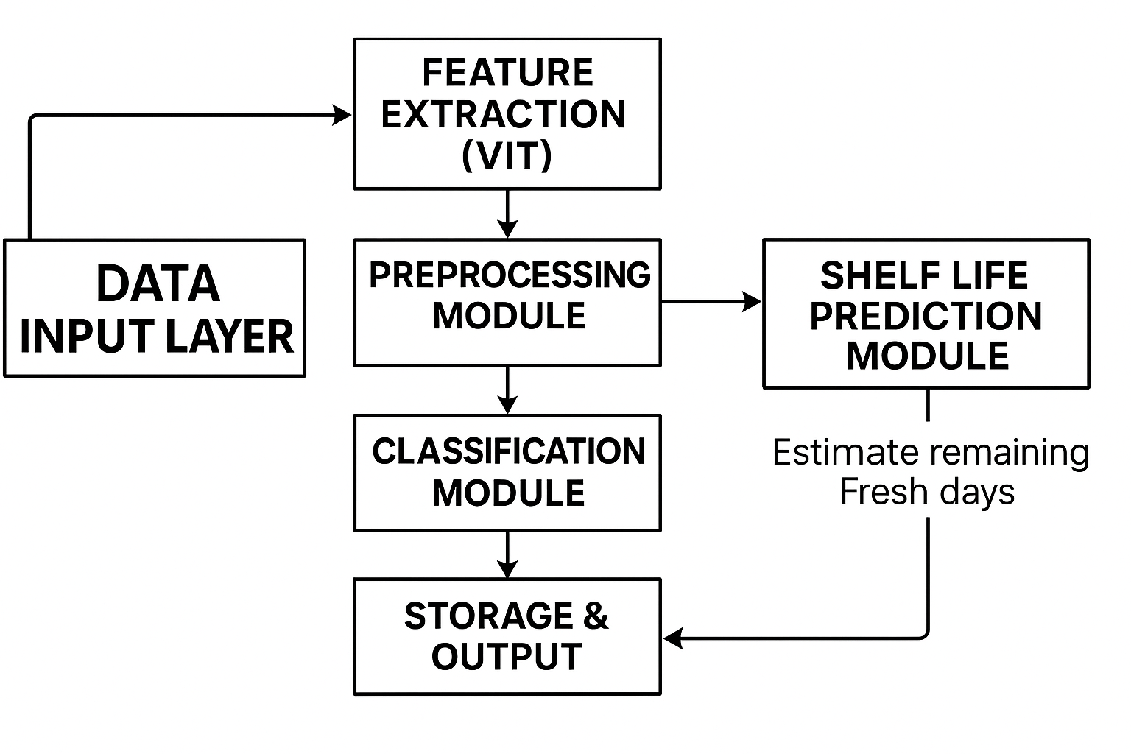
Visual Representation of Working of Project

Slide 6
Prerequisites
Google Colab
Windows 10 64-bit
Intel Core i5-13450HX
RAM 8 GB
Graphics Card: NVIDIA RTX 3050
VS Code
Frameworks & Libraries:
PyTorch
Scikit-learn (sklearn)
OpenCV
NumPy
Matplotlib
Pandas

Slide 7
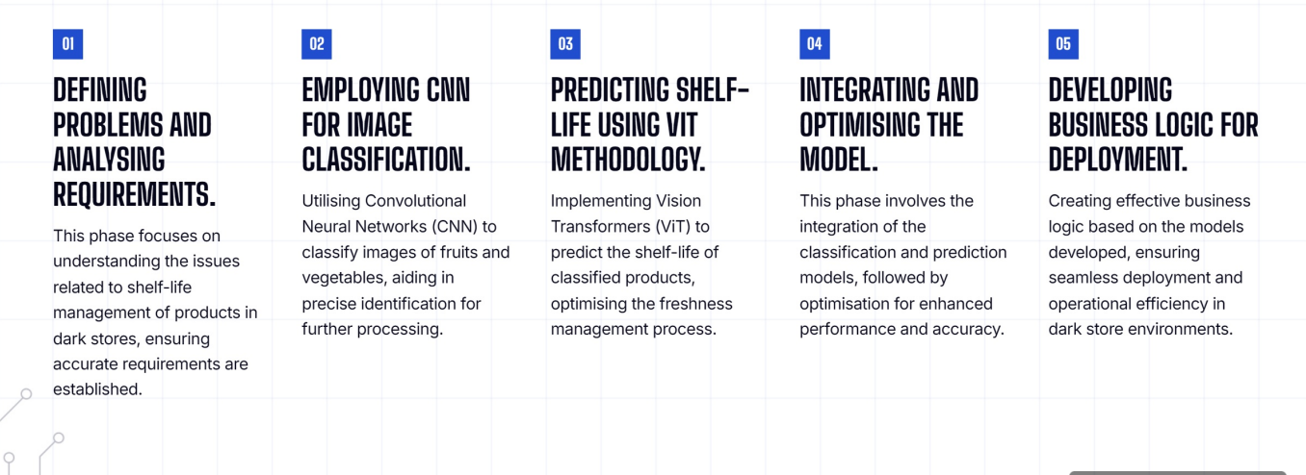
Phases of Project Development

Slide 8
Data Preprocessing
One of the essential step in predicting fruit and vegetable shelf life, transforming raw information into usable insights for machine learning. It starts with collecting diverse data like intrinsic produce qualities, environmental conditions from IoT sensors, and historical spoilage records, then integrating these disparate sources. Next, data cleaning tackles missing values, outliers, and noise, while ensuring consistency across units. Feature engineering then extracts more meaningful variables, such as cumulative exposure to temperature or rates of change, and encodes categorical data. Finally, data transformation scales and normalizes features before the dataset is carefully split into training, validation, and test sets, always ensuring chronological order for time-series data to avoid leakage.

Slide 9
Shelf-Life Prediction
We explored several models like Logistic Regression, CNN, and Artificial Neural Networks (ANN). After rigorous experimentation, we confidently adopted the Vision Transformer (ViT), a transformer-based architecture originally designed for image classification. ViT proved exceptionally accurate in capturing both spatial and temporal patterns in fruit degradation. Simultaneously, we began writing our research paper and investigated both binary classification (fresh vs spoiled) and quantitative prediction (number of shelf-life days remaining).

Slide 10
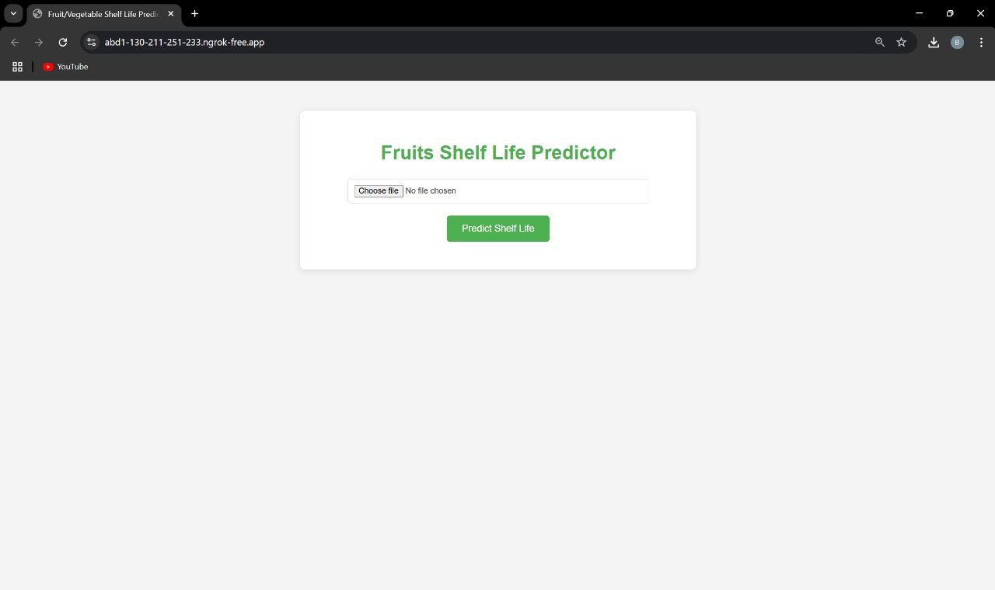
Implementation

Slide 11
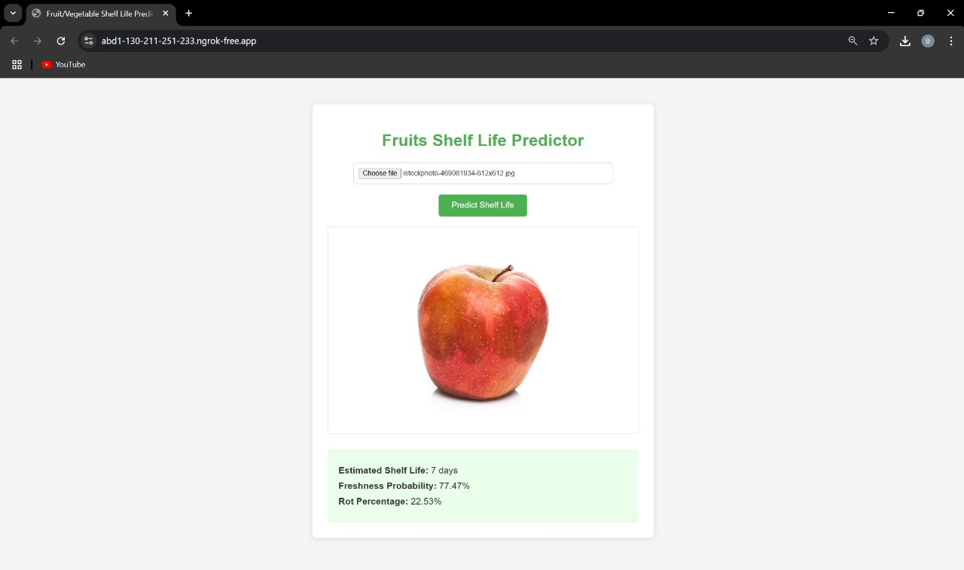

Slide 12
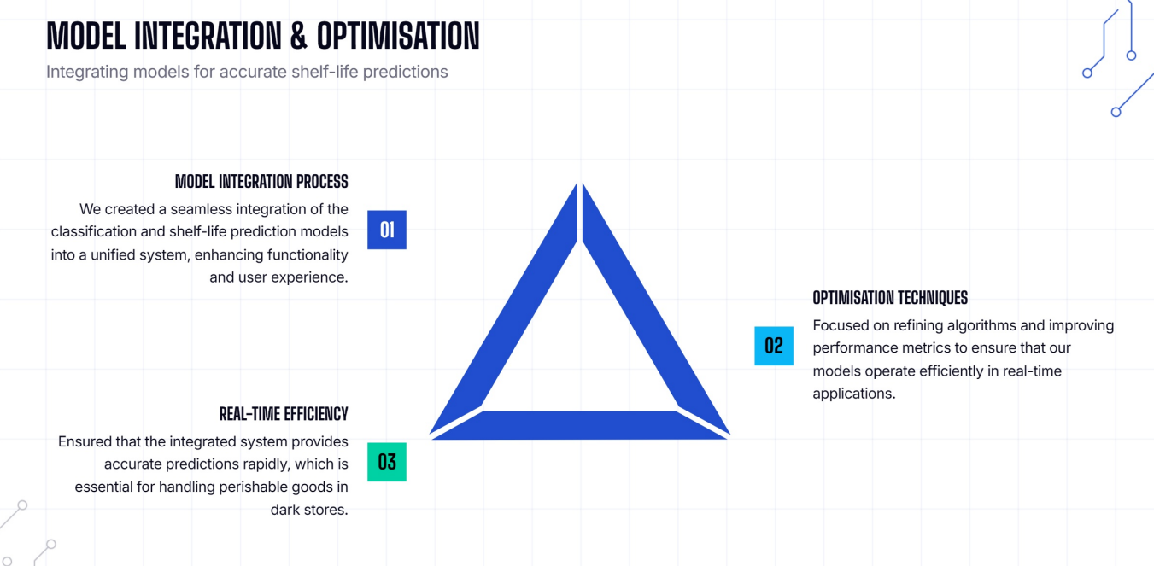
Integrating and Optimizing

Slide 13
Conclusion
In conclusion, our ViT-based model successfully classified fruit freshness with 96.82% validation accuracy and accurately predicted shelf life within ±1 day for over 91% of cases. This robust system offers significant potential for reducing food waste and optimizing supply chain logistics through precise, early decay detection. This work provides a practical tool for intelligent sorting and logistical planning, contributing to greater efficiency and sustainability in the agricultural sector.

Slide 14
Applications
Supermarkets: AI predicts spoilage, ensuring fresher shelves and cutting waste.
Farmers: Smart scanners direct fruit to local sales or lucrative international exports.
Logistics: Real-time data drives dynamic temperature adjustments in trucks, preserving produce.
Food Tech: Handheld devices instantly provide precise shelf life for produce like avocados.
Grocers: Automated prioritization of expiring produce guarantees customer freshness.
Global Trade: Delicate fruits now confidently traverse continents, arriving fresh.

Slide 15
Thanks you

